Slide 1
Computer Networking
Network Model
Chapter 2

Slide 2
Protocol Layering
Protocol: The rules that the sender, receiver and all intermediate devices follow to communicate effectively
Simple communication → Simple protocol
Complex communication → Protocol layering
Computer networks are complex systems
Tasks involve varieties of hardware and software components, and protocols
Networking task is divided into several subtasks, or layers

Slide 3
Real World Example
Communication between managers of two companies
Communicate

Slide 4
What Actually happens
Communication takes place thru many layers
Logical communication
Secretary: reads and reports the message
Secretary: types a letter
Delivery boy: drops the letter
Delivery boy: takes the letter
Postal truck
Post office:
Processes and routes the letter

Slide 5
Layer Model
Layer N uses services provided by Layer N-1
HOST A
HOST B
Logical communication path
Layer N
Layer N
Layer N protocol
Using services
Providing services
Layer N-1
Layer N-1
Layer N-2
Layer N-2
Virtual Communication System

Slide 6
Why Layers?
Guidelines for protocol developments
Reference model
Modularity
Eases maintenance and updating of systems
A change in one layer is transparent to the rest
It allows us to separate the services from the implementation.

Slide 7
Two Principles of Protocol Layering
Bidirectional communication.
The objects under each layer at both sites should be identical.

Slide 8
Internet Layer Model: TCP/IP Protocol Suite
The Internet Protocol Stack
User
Application Layer
Transport Layer
Network Layer
Data Link Layer
Physical Layer
Software
Hardware
Transmission Medium

Slide 9


Application Layer
Responsible for providing services to the user
The only layer to interact with user
Data
Logical communication
Data
Application Layer
SMTP
HTTP
FTP
SMTP
HTTP
FTP
Data
H5
Data
H5
to Transport
from Transport

Slide 10
Transport Layer
Responsible for delivery of a message from one process to another
Duties/services
Port addressing
Segmentation and reassembly
Connection control
Flow control (end-to-end)
Error control (end-to-end)

Slide 11
Transport Layer
Process
Process
…
Process
Process
…
PORT #
PORT #
Data
Data
Transport Layer
Data₁
H4
Data₂
H4
Data₃
H4
Data₁
H4
Data₂
H4
Data₃
H4
(segments)
to Network
from Network

Slide 12
Network Layer
Responsible for the delivery of packets from the original source to the destination
Duties/services
Logical addressing
Routing

Slide 13
Network Layer
from Transport
to Transport
Data
Data
Network Layer
Data
H3
Data
H3
(packet)
to Data Link
from Data Link

Slide 14

Network Layer
Data
1.1
5.7
1.1, 1.2, 6.1, 5.7, ... are logical addresses
1.1
1.2
Network 1
R1
6.1
Network 6
6.6
6.3
R3
R2
5.2
Router
3.3
Network 5
5.7
Network 3
3.8

Slide 15
Data Link Layer
Responsible for transmitting frames from one node to the next
Duties/services
Framing
Physical addressing
Flow control (hop-to-hop)
Error control (hop-to-hop)
Access control

Slide 16
Data Link Layer
from Network
to Network
Data
Data
Data Link Layer
T2
Data
H2
T2
Data
H2
(frame)
to Physical
from Physical

Slide 17
Data Link Layer
A3, 3B, 82, 9F, ... are physical addresses
Data
9F
3B
82
A3
T2
Data
9F
A3
H2

Slide 18
Data Link Layer
Data
1.1
5.7
1.1
1.2
97
32
Network 1
Data
1.1
5.7
97
25
25
R1
6.1
79
Network 6
Data
1.1
5.7
79
62
6.6
6.3
62
12
R3
R2
5.2
54
88
3.3
Data
1.1
5.7
54
74
Network 5
5.7
Network 3
74
3.8

Slide 19
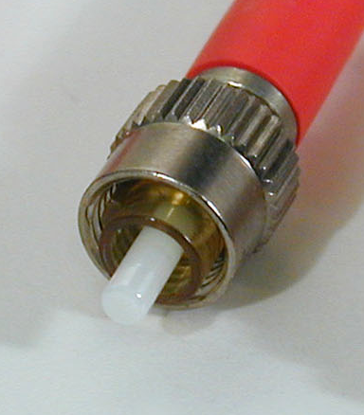
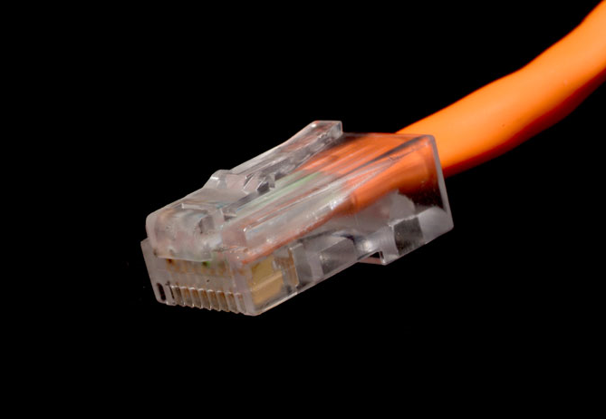
Physical Layer
Responsible for transmitting individual bits from one node to the next
Duties/services
Physical characteristics of interfaces and media
Representation of bits
Data rate (transmission rate)
Synchronization of bits

Slide 20
Physical Layer
from Data Link
to Data Link
Data
Data
Physical Layer
01001011
01001011
(bits)
Transmission medium

Slide 21
The Big Picture
5
5
L5 data
H5
L5 data
H5
4
4
L4 data
H4
L4 data
H4
3
3
L3 data
H3
L3 data
H3
2
2
T2
L2 data
H2
T2
L2 data
H2
1
1
0111011010101001010101001
0111010101010010101010101
Transmission medium

Slide 22
Internet Model
sender
router
router
receiver
Application
Transport
Network
Data Link
Physical
Application
Transport
Network
Data Link
Physical
Network
Network
D.L.
D.L.
D.L.
D.L.
P.L.
P.L.
P.L.
P.L.
Transmission medium

Slide 23
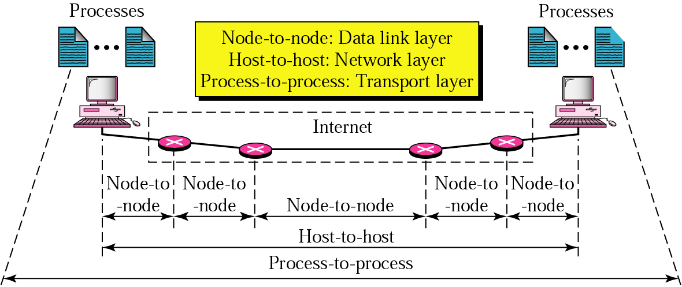
Internet Model

Slide 24
Protocol Suites
A set of protocols must be constructed
to ensure that the resulting communication system is complete and efficient
Each protocol should handle a part of communication not handled by other protocols
How can we guarantee that protocols work well together?
Instead of creating each protocol in isolation, protocols are designed in complete, cooperative sets called suites or families
Notes:
24

Slide 25
Internet Protocol Suite
Layer | Protocols
Application | HTTP, FTP, Telnet, SSH, SMTP, DNS, SNMP, IGMP, …
Transport | TCP, UDP, SCTP, ...
Network | IP (IPv4), IPv6, ICMP, IGMP, ARP, RARP, ...
Data Link | Ethernet, Wi-Fi, PPP, ...
Physical | RS-232, DSL, 10Base-T, ...

Slide 26
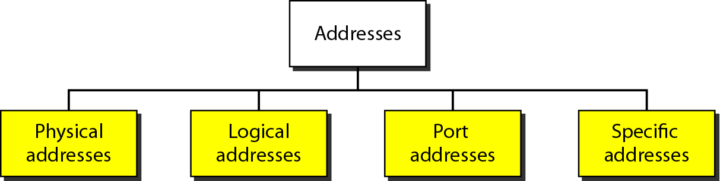
Addresses in TCP/IP
Notes:
26

Slide 27
Addressing in TCP/IP
Packet Names
Layers
Addresses
Message
Application Layer
Transport Layer
Network Layer
Data Link Layer
Physical Layer
Specific Addresses
Segment/User
Datagram
Port Addresses
Datagram/Packet
Logical Addresses
Frame
Physical Addresses
Bits

Slide 28
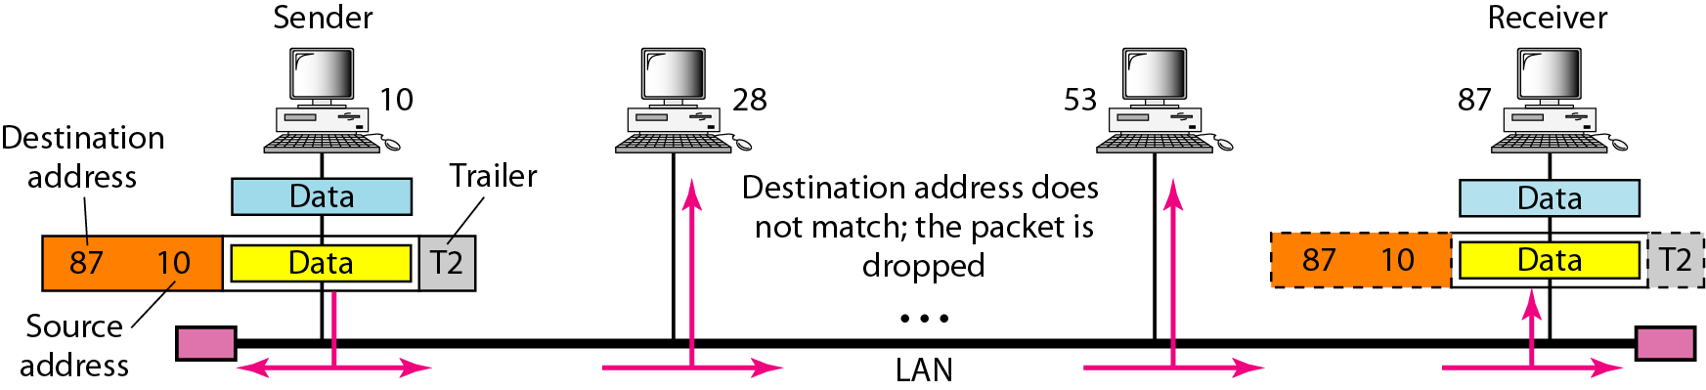
Physical Addresses
Notes:
28

Slide 29
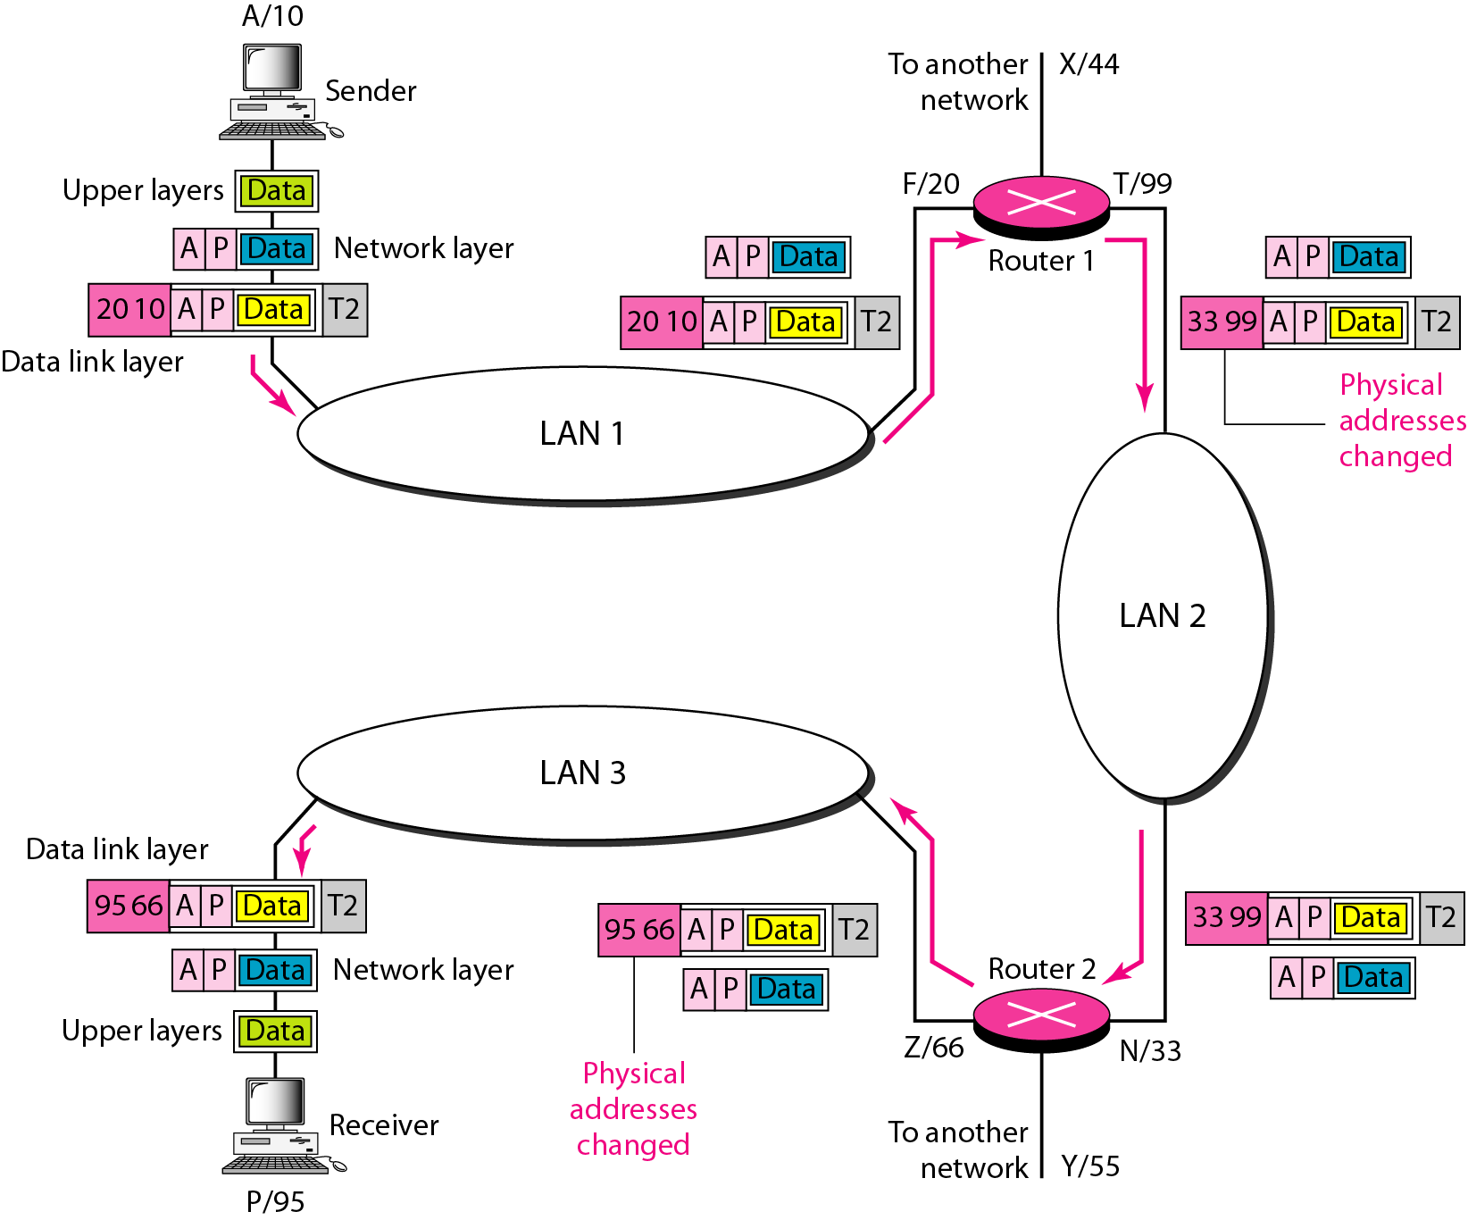
Logical/IP Addresses
Notes:
29

Slide 30
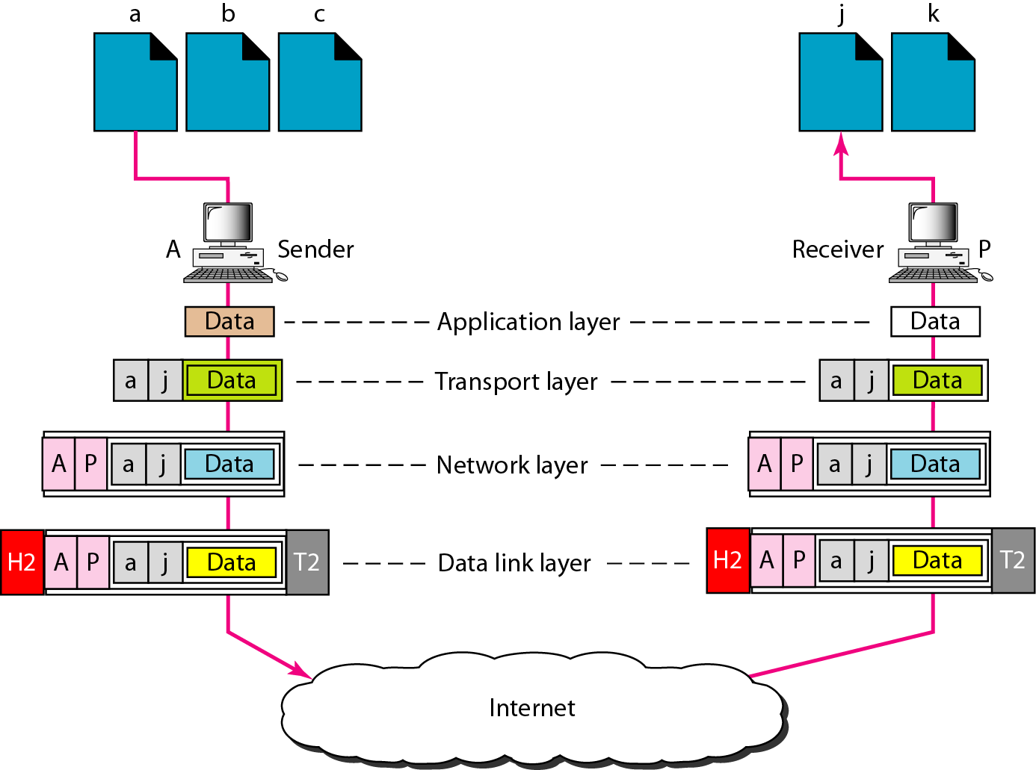
Port Addresses
Notes:
30

Slide 31
OSI Model
User
OSI – Open Systems Interconnection
Developed by the International Standards Organizations (ISO)
Two additional layers
Presentation layer
Session layer
7.Application Layer
6.Presentation Layer
5.Session Layer
4.Transport Layer
3.Network Layer
2.Data Link Layer
1.Physical Layer
Transmission Medium

Slide 32
Session Layer
Responsible for establishing, managing and terminating connections between applications
Duties/services
Interaction management
⇨ Simplex, half-duplex, full-duplex
Session recovery

Slide 33
Presentation Layer
Responsible for handling differences in data representation to applications
Duties/services
Data translation
Encryption
Decryption
Compression

Slide 34














OSI Layers in Real World
7.Manager
Handwrites a message
Reads the message
Prepares final version
Summarizes or translates letter
6.Assistant
Provides address and packs letter
Opens letter
5.Secretary
Delivers letter to post office
Withdraws letter from mailbox
4.Driver
Checks address and sorts letter
Checks address and sorts letter
3.Postal staff
Packs letters for certain directions
Unpacks packages
2.Postal staff
Loads on truck
Unloads from truck
1.Postal staff
transmission medium
Pictures from Wikipedia

Slide 35
Lack of OSI Model’s Success
Costly
Some of layers were never fully defined
Performance
Few Slides taken and modified from Chaiporn Jaikaeo

